Slide 1


SKILLX PROJECT
PRESENTATION
By REHAN MERAJ ANSARI

Slide 2

Human Following Arduino-Based Robot
An Innovative Application of Robotics and AI
By b.tech cse department, section - d

Slide 3

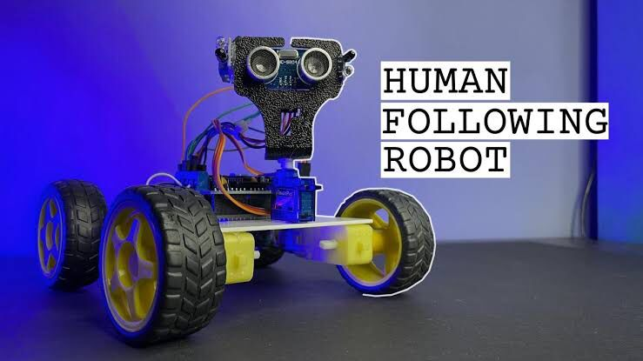
Introduction
An Arduino-based human-following robot is a robotic system designed to autonomously track and follow a human target using sensors and a microcontroller. It combines mobility and automation to provide practical solutions in fields like caregiving, logistics, and personal assistance. Built with components such as ultrasonic sensors, motor drivers, and an Arduino board, this robot adjusts its movements in real-time to maintain proximity to the user, showcasing the potential of robotics in enhancing everyday life.

Slide 4

ACKNOWLEDGEMENT
Thanks everyone for all of your support and guidance in completing this project! This project could not have been accomplished without the support and encouragement of my team. The deepest gratitude goes to JIS University for inviting me to SkillX, an engine of creativity and innovation. It has been rewarding, and an ever-learning process for me.
I would also like to thank my sincere team members Md Amir Ansari, Pintu Kumar, Zaheed Hussain and Abdul Qadir and my mentor Mr. Suprativ Saha for helping me accomplish this project.
In reference I would like to thank websites www.robocraze.com, www.youtube.com, www.nordborobotics, for helping me overcome the difficult coding and programming tasks.
Rehan Meraj Ansari
B.tech in AI & ML
JIS UNIVERSITY

Slide 5

Objective
The objective of making an Arduino-based human-following robot is to develop an intelligent system capable of autonomously tracking and following a human target. This robot aims to combine mobility with automation, utilizing sensors like ultrasonic or infrared to detect and maintain a safe distance from the user. Such a system is designed to enhance convenience and functionality in various applications, including assisting the elderly, aiding in logistics, and serving as personal companions. By leveraging Arduino’s flexibility and affordability, the project seeks to provide an innovative, efficient, and cost-effective solution for human-robot interaction.

Slide 6

Components Used
The components required to build an Arduino-based human-following robot include an Arduino Uno, a motor driver shield, four wheels, and four TT gear motors. Additional components include a servo motor, an ultrasonic sensor, and two infrared sensors. Power is supplied by two 18650 Li-ion batteries along with a 18650 battery holder. For connections, male and female jumper wires are used. The structure of the robot can be built using an acrylic sheet (available in offline stores). Finally, a DC power switch is included to control the power supply.

Slide 7

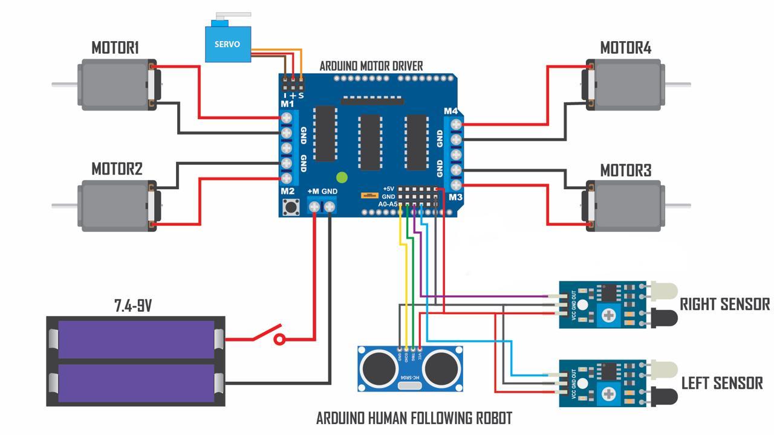
CIRCUIT DIAGRAM

Slide 8

Working Principle
The working principle of an Arduino-based human-following robot involves detecting a human target and adjusting its movement accordingly. Ultrasonic and infrared sensors continuously measure the distance and direction of the target. This data is processed by the Arduino, which calculates the necessary movement commands. The motor driver then controls the wheels’ motors to adjust the robot’s speed and direction, enabling it to follow the target while maintaining a safe distance. This real-time feedback system ensures accurate and responsive tracking.

Slide 9

Applications
The Arduino-based human-following robot has diverse applications, including assisting the elderly and disabled by carrying items or providing mobility support. It is used in logistics for automated material handling and delivery. Additionally, it serves as a personal companion for entertainment or guidance in smart homes and can be employed in industrial automation for tasks like warehouse management and transportation.

Slide 10

Conclusion
In conclusion, the Arduino-based human-following robot represents a significant step in robotics, combining affordability, efficiency, and practicality. With its ability to track and follow humans autonomously, it offers innovative solutions across various fields, including caregiving, logistics, and industrial automation. This project not only demonstrates the potential of integrating sensors and microcontrollers but also paves the way for further advancements in human-robot interaction, enhancing convenience and productivity in everyday life.

Slide 11

TEAM MEMBERS
Rehan Meraj ANSARI (B.tech in Ai & ml)
Md amir Ansari (B.tech cse Data Science)
Yuvraj singh (b.tech CSE data science)
Ankit gupta (B.tech CSe data science)
Abdul qadir (b.tech cse data science)
Mentor – Mr. Suprativ saha

